Slide 1
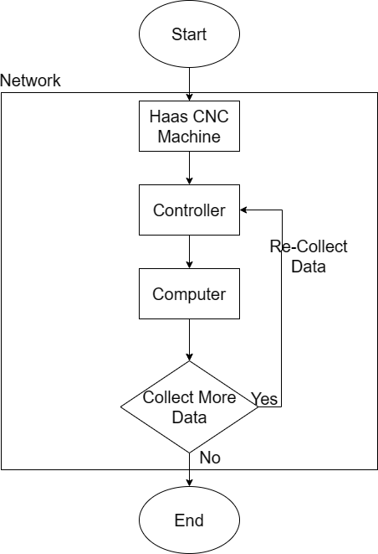
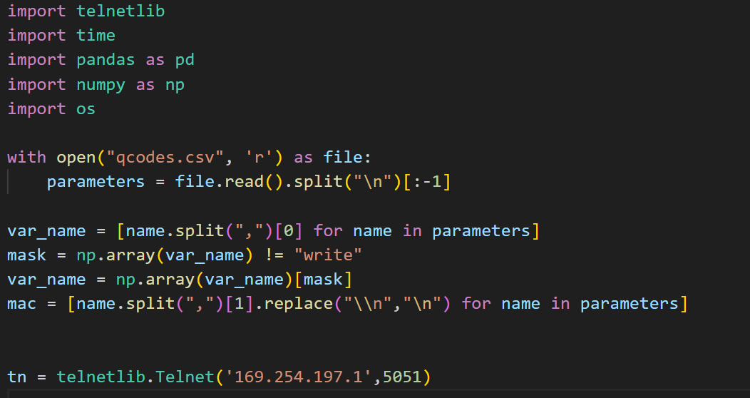
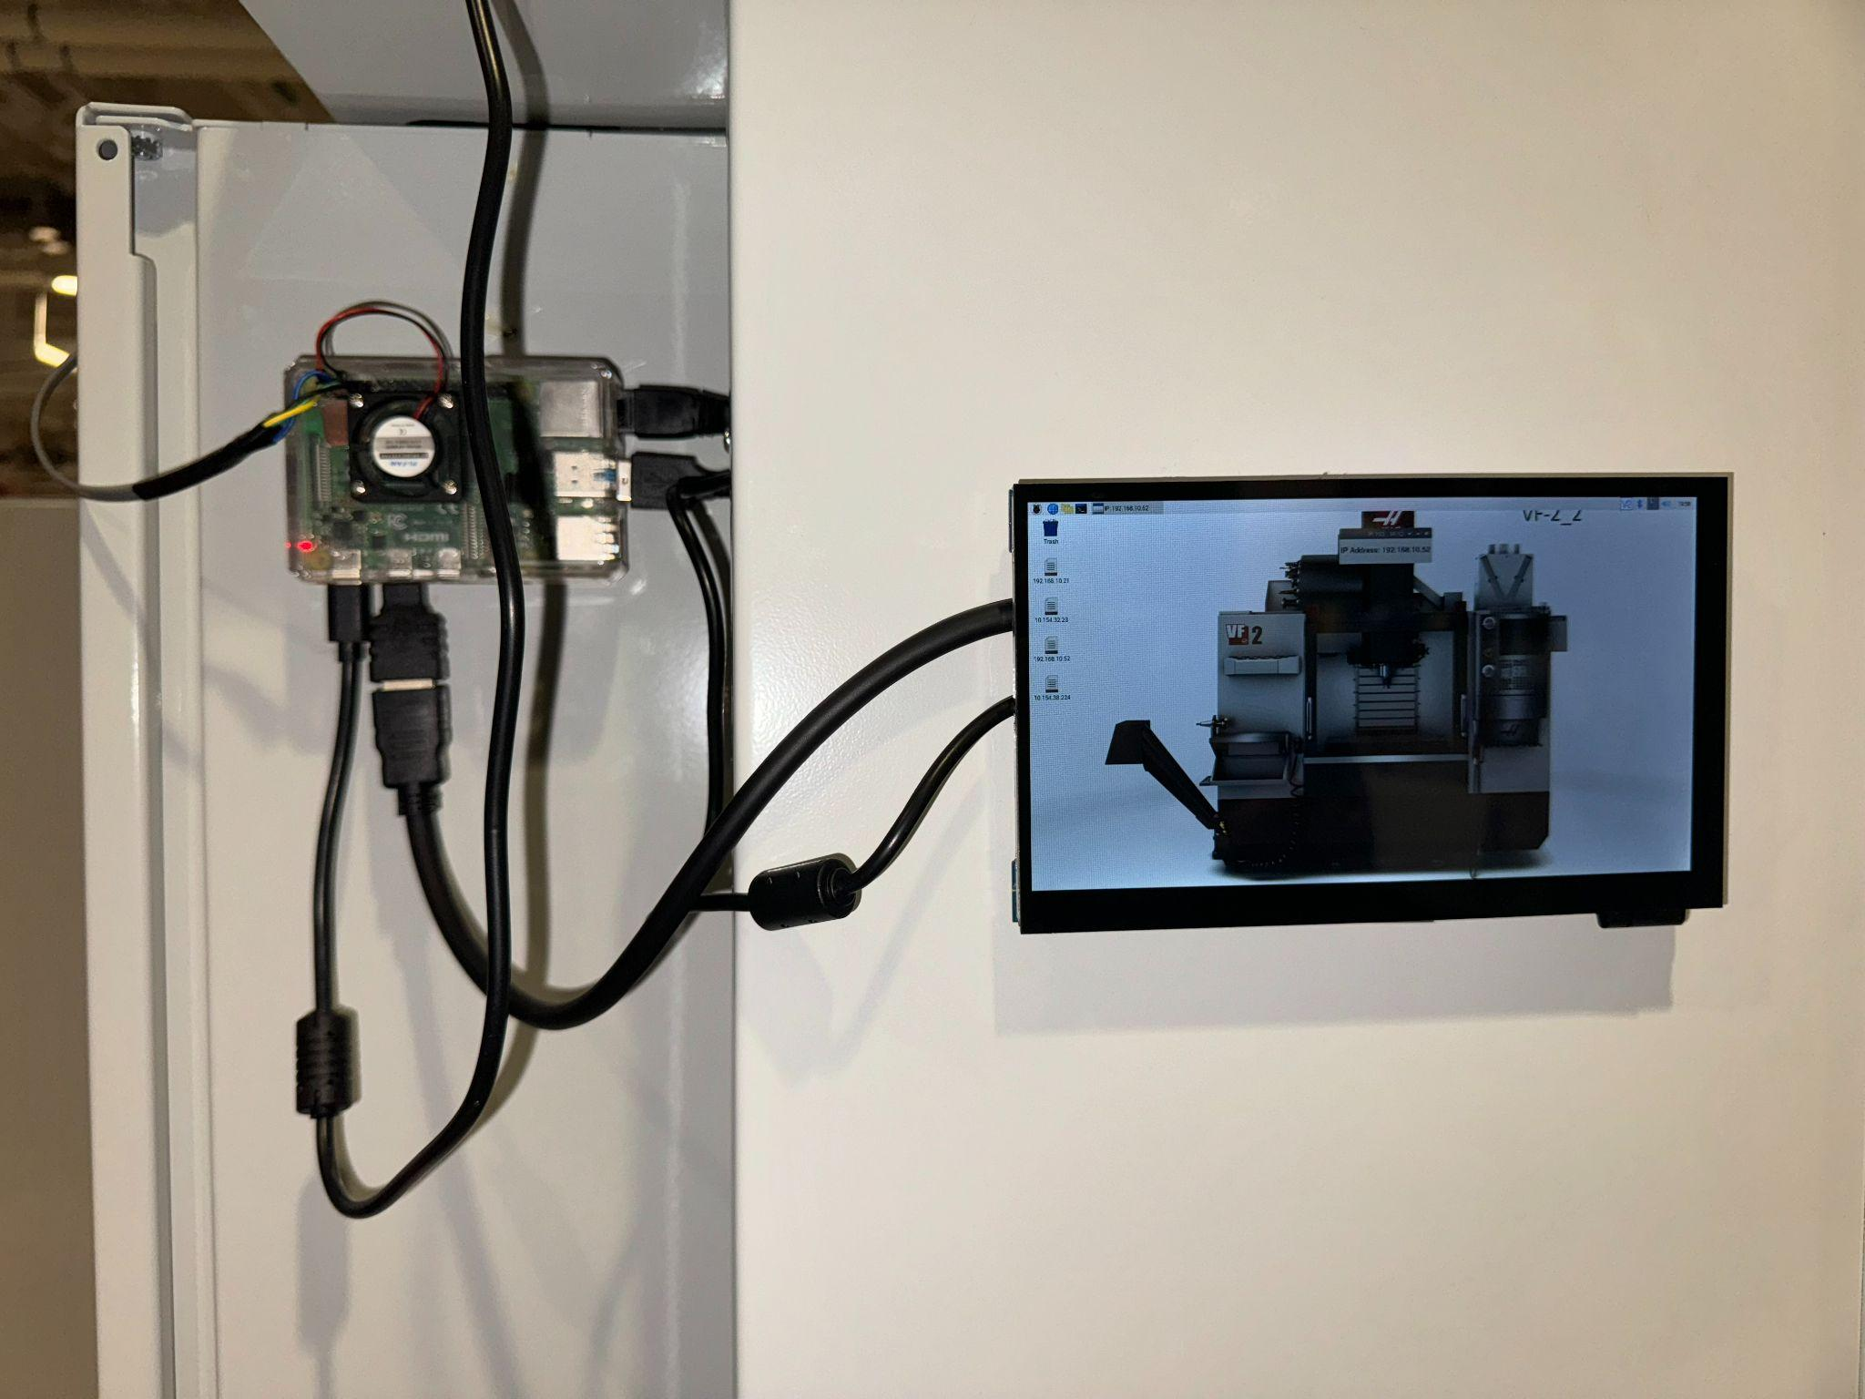
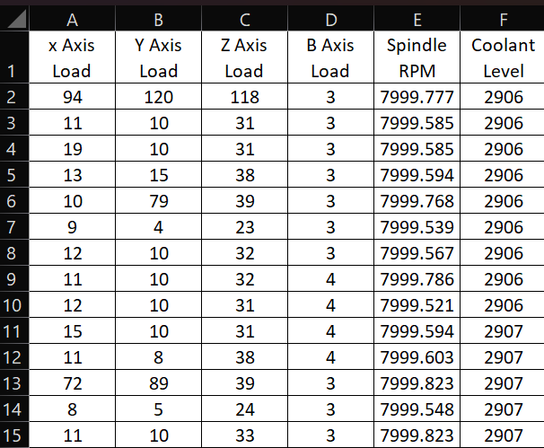
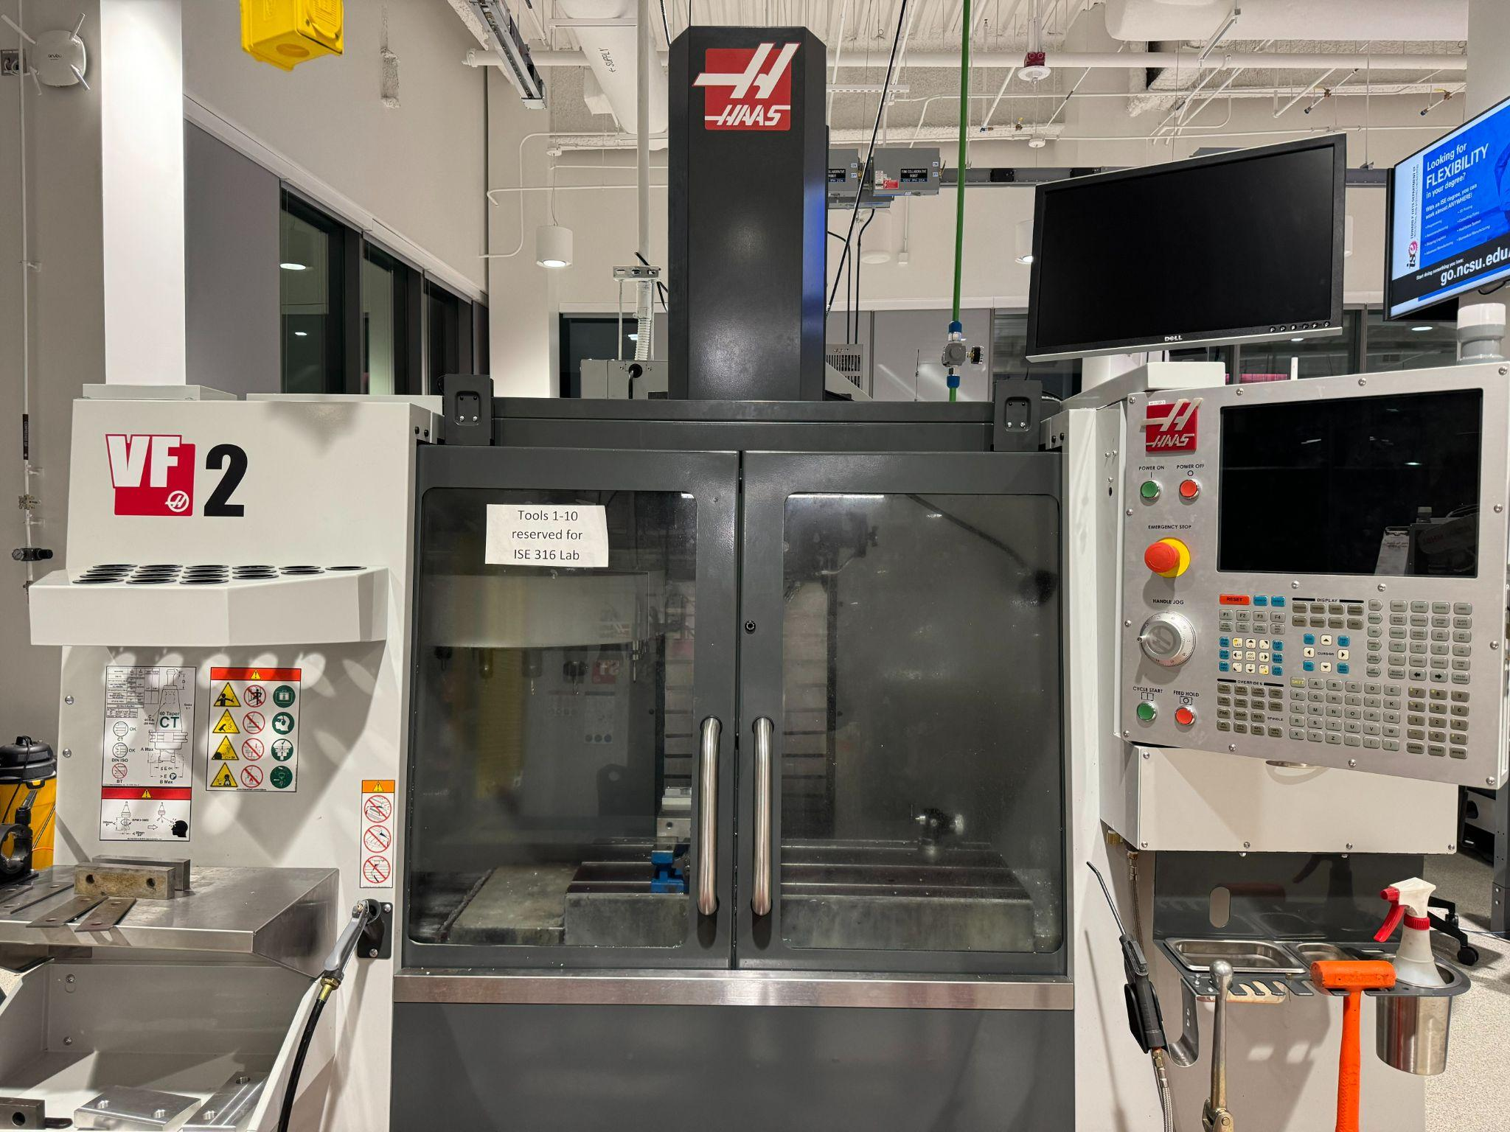
AI-Based Manufacturing System for Production Optimization and Cost Reduction
Rishi Yadav, Sourabh Saptarshi, Jatan Pandya, and Veeraraghava Raju Hasti
MAE 589 – 011: Artificial Intelligence for Engineering Applications, Fall 2023
Project Advisor: Prof. Veeraraghava Raju Hasti, Ph.D.
Abstract
Methodology
Preliminary Code Snippet and Real Time Database
Predicting and preventing defects is essential for maintaining quality, reducing costs, and improving overall efficiency.
Traditional methods such as manual inspection and statistical process control, are often time-consuming, labor-intensive, and prone to error.
Data Collection
Pre-processing
Cleaning & Filtering
Normalization
Segmentation
Training & Validation
Hyperparameter Tuning
Performance Evaluation
Fig 4. Data Collection Code
Introduction
Tabel 1. Database used for training supervised model
Manufacturing has witnessed substantial advancements through the integration of intelligent monitoring systems into Computer Numerical Control (CNC) machines.
Use of ML for defect detection has been studied in a variety of manufacturing domains, including machining, welding [1], and assembly [2].
ML has the potential to revolutionize defect detection in manufacturing by providing real-time, accurate, and cost-effective solutions [3].
Machine learning algorithms can accurately identify patterns and anomalies that indicate the presence of defects [4].
Information can be used to trigger corrective actions, such as machine shutdowns or product recalls, which can help to prevent further damage and waste.
Fig 1. Data Collection Flowchart
Fig 2. Raspberry Pi Controller in Haas
Future Work
Haas VF 2 Machine used for Data Extarction
Use AI to check tool inventory in the machine and potentially replace the worn tool before damage to continue the job at hand.
Publish paper in a peer reviewed journal preceding if we get novel results.
Acknowledgments
We would like to thank ISE Manufacturing Lab (NC State University) and Mr. Tim Coleman (Processes Lab Manager) for providing us access to the machine and Mr. Pavel ‘Pasha’ Koprov for letting us use his raspberry pi system to extract real time data from the machine.
Objectives/ Goals of the project
Extract real-time data from Haas 3 axis CNC machines during live milling operation.
Develop an AI-powered system that can proactively identify tool malfunctions and if necessary terminate the operation.
References
[1] Amarnath, M., Sudharshan, N., Srinivas, P., 2023. Automatic detection of defects in welding using deep learning - a systematic review. Materials Today: Proceedings. https://doi.org/10.1016/j.matpr.2023.03.268
[2] Schuh, G., Gützlaff, A., Thomas, K., Welsing, M., 2021. Machine learning based defect detection in a low automated assembly environment. Procedia CIRP, 54th CIRP CMS 2021 - Towards Digitalized Manufacturing 4.0 104, 265–270. https://doi.org/10.1016/j.procir.2021.11.045
[3] Kaiser, J., Terrazas, G., McFarlane, D., de Silva, L., 2021. Towards low-cost machine learning solutions for manufacturing SMEs. AI & Soc. https://doi.org/10.1007/s00146-021-01332-8
[4] Yang, J., Li, S., Wang, Z., Dong, H., Wang, J., Tang, S., 2020. Using Deep Learning to Detect Defects in Manufacturing: A Comprehensive Survey and Current Challenges. Materials (Basel) 13, 5755. https://doi.org/10.3390/ma13245755
Fig 3. Haas VF 2 machine at ISE Manufacturing Lab

