Slide 1
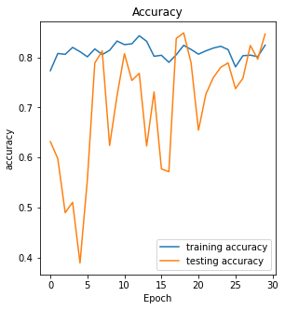
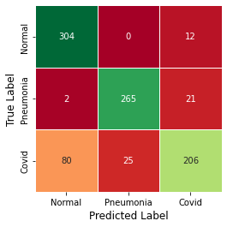
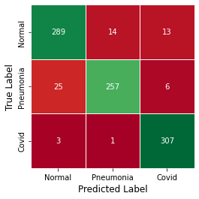
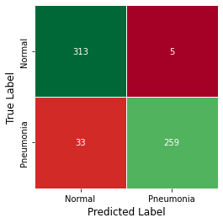
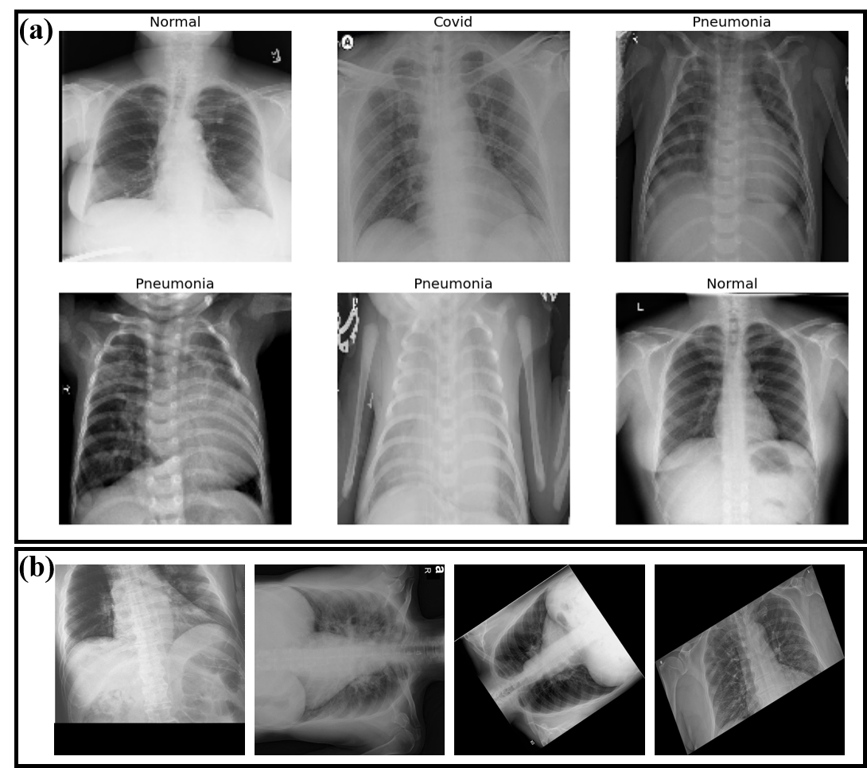
Using AI Techniques to Detect Potential COVID-19 Patients
Shang-Ru, Li, Veeraraghava Raju Hasti
MAE 495 – 011 and MAE 589 – 011: Artificial Intelligence for Engineering Applications, Fall 2023, Project Advisor: Prof. Veeraraghava Raju Hasti, Ph.D.
Abstract
Using deep Convolutional Neural Networks (CNNs) is ubiquitous while dealing with image data. However, as the network architecture becomes deeper, the training performance gradually deteriorates due to the phenomenon of vanishing or exploding gradients during backward propagation in the training process. In order to solve the aforementioned problems, ResNet introduced the concept of Residual Block. In each residual block, there is a shortcut connection that passes, or identity maps the input x to one or more layers behind and then combines with the residual mapping F(x) to form a new mapping function F(x)+x. Assuming the expected mapping function is H(x), the setting of the residual block makes the network able to learn the
residual mapping function F(x) = H(x) − x, which can also guarantee the stability of gradient descent. In this project, ResNet-50 is adopted, which can be seen in
Fig.2.
In this project, we use artificial neural networks to execute classification tasks on Chest X-ray images in order to detect potential COVID-19 patients. A general convolutional neural network model is first utilized to ensure the feasibility of performing image classification tasks on a given dataset with three labels. ResNet is later used on the same dataset with two categories only, and the training weights are saved for the following transfer learning purpose. Finally, ResNet with the pre-trained weights is exploited on the ternary classification task. The result proves the usefulness of using transfer learning on an unseen category.
Introduction
During the pandemic, he common method for screening is Polymerase Chain Reaction (PCR) Test, but the shortage of testing kits also occurred frequently, especially during the pandemic’s peaks. When the huge kit requirement happens, the detection using Chest X-ray (CXR) images seems more promising, where image recognition and classification techniques assisted by AI can be utilized.
Nonetheless, most research regarding using deep learning techniques on image classification of COVID-19 cases did not mention how to address the issue of fast-emerging COVID variants. To make it clearer, while researchers commonly recommend employing a neural network model pre-trained on public image databases like ImageNet before classifying CXR images, there is limited discussion on extending an existing neural network model trained on specific categories to effectively handle an unseen category associated with a new variant. Therefore, in this project, we will discuss the feasibility of using the transfer learning technique on this issue.
Fig. 5: Training history for ResNet in ternary classification with transfer learning.
Fig. 6: Confusion matrix of testing data for ResNet in ternary classification with transfer learning.
Conclusion and Discussion
To make the comparison, we cancel loading the pre-trained weights (without transfer learning) while doing the ternary classification task. Fig.7 and Fig.8 show the training history and the relevant confusion matrix, respectively. From the figure, we can observe that the training accuracy can achieve 97.90%, and the testing accuracy reaches 93.22%.
Fig. 2: A brief summary of the architecture of ResNet-50 used in this project.
Objectives/ Goals of the project
Results
The major goal of this project is to help students utilize the knowledge learned from the class on practical issues.
In the beginning of this project, a ResNet-50 model has been adopted and performed on the binary classification task (Normal vs. Pneumonia) first. The training accuracy can achieve 99.83%, and the testing accuracy is 93.77%. In this case, the training history is shown in Fig.3, and the related confusion matrix can be seen in Fig.4. After that, we save the weights of ResNet (only a layer called resnet50 in Fig.2b) for further transfer learning.
Methodology
In this project, a dataset of CXR images with three channels is from Mendeley database (see Fig.1a), which contains 1525 CXR images of COVID-19 cases with data augmentation (see Fig.1b), 1525 pneumonia cases, and 1525 normal cases, respectively. The dataset is split into 80 / 20% for training / testing. Furthermore, all the images are resized to 150 × 150 pixels before training.
Fig. 7: Training history for ResNet in ternary classification without transfer learning.
Fig. 8: Confusion matrix of testing data for ResNet in ternary classification without transfer learning.
However, compared with the same image classification task without transfer learning, the model with the pre-trained weights (Fig.6) does shorten the training time by 71.56% even though it simultaneously reduces the testing accuracy by 8.52%. Hence, it is actually the trade-off between the training time and accuracy.
Accordingly, the assumption that the feature maps generated during the binary classification (Normal and Pneumonia) can be transferred to the ternary classification (Normal, Pneumonia, and Covid) has been proven possible. This finding is especially useful when new virus variants emerge frequently.
Fig. 3: Training history for ResNet in binary classification.
Fig. 4: Confusion matrix of testing data for ResNet in binary classification.
To do the transfer learning with a new category, we start from the same architecture. In the resnet50 layer, we load the weights saved previously and then launch the classification training process with three categories (Normal, Pneumonia, and Covid). After training, we get the result indicating that the training accuracy is 82.47%, and the testing accuracy is 84.70%. For this case, the training history is shown in Fig.5, and the related confusion matrix can be seen in Fig.6.
Future Work
Explore integrating diverse data, such as combining X-ray images with other diagnostic methodologies, which may contribute to improving classification accuracy.
Fig. 1: CXR dataset with (a). Three categories and (b). Augmented samples (zoom, rotation, and shear).
Acknowledgments
I extend my deepest gratitude to my project advisor, Dr. Hasti, for his patient guidance and encouragement.

