Slide 1

MAE 253: Experimental Aero 1 Introduction to Xfoil
Pranav Hosangadi
Feb 26-28, 2019

Slide 2
Outline
What is Xfoil?
Installation problems?
Typical analysis workflow
NACA airfoil
Custom airfoil
Plotting results
Automation
Comparing with experiments

Slide 3
Introduction
Xfoil is an open-source Fortran code written by Prof. Mark Drela and Harold Youngren
http://web.mit.edu/drela/Public/web/xfoil/
Subsonic airfoil design / analysis
Some capabilities: Inviscid, viscous analysis, airfoil design (direct and inverse)
Create airfoil polars
Cp distributions
Simple BL calculations
Interactive or through a script
Good “sanity check” for experimental data
http://web.mit.edu/drela/Public/papers/xfoil_sv.pdf

Slide 4
Installation problems?
Go to https://vcl.ncsu.edu
Create a new Windows reservation
Download xfoil for Windows, extract to C:\Users\<you>\Downloads\XFOIL6.99
Add “C:\Users\<you>\Downloads\XFOIL6.99” to path
See a TA during office hours

Slide 5
Running Xfoil
Working directory
Xfoil reads/writes in this directory unless you enter the full path
cd (Win)
pwd (UNIX)
Open command prompt / terminal, navigate to your working directory
cd working_dir (Win & UNIX)
xfoil
? ➔ shows the list of commands you can give xfoil

Slide 6
List of commands
1-4 letter commands
Some commands take arguments
“r”: Expects a real number
“i”: Expects an integer
“f”: Expects a file name
“s”: Expects a string
“.” before a command: Drill down menu
“.” is not a part of the command
Give commands in one line or multiple lines
Commands are not case-sensitive

Slide 7
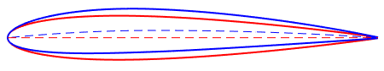
Loading a NACA airfoil
Xfoil can generate NACA 4- or 5-digit airfoil profiles from the equations
NACA 4-digit airfoils: e.g.: NACA 0012 (symmetric) or NACA 2412 (cambered)
NACA mpT ➔ Generates a NACA airfoil. m = maximum camber as % chord (1 digit) p = location of max. camber / chord * 10 (1 digit) T = Maximum thickness as % of chord (2 digits)

Slide 8
Cleaning up geometry
After loading, check geometry
sharp angles between panels
coarse distribution of panels
PPAR: Increase number of panels, distribution of panels, etc.
N 250
PANE: smoother airfoil if sharp angles

Slide 9
Setting up a viscous simulation
OPER (find operating points)
VISC 3e6 (Enable viscous mode, Re=3M)
ITER 100 (Increase number of BL iterations)
INIT (Initialize BL solver to alpha=0)
PACC (Save polar to file)

Slide 10
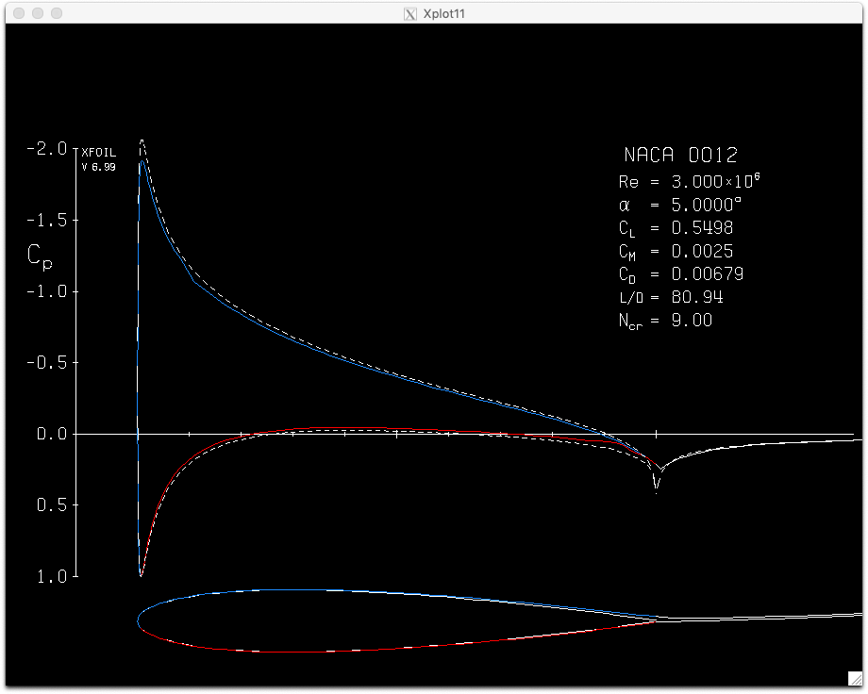
Finding operating points
OPER
ALFA 5
What’s in the output window?

Slide 11
Finding operating points
OPER
INIT
ASEQ 0 25 1
INIT
ASEQ 0 -10 -1
PACC

Slide 12
Other OPER options
CPX
CPV
VPLO
DUMP
CPWR
VPAR
XTR

Slide 13
Viewing polars
Polar file format
pplot
Cl vs Cd polar, drag bucket
Cl vs alfa
Cm vs alfa
Reading polar files in MATLAB

Slide 14
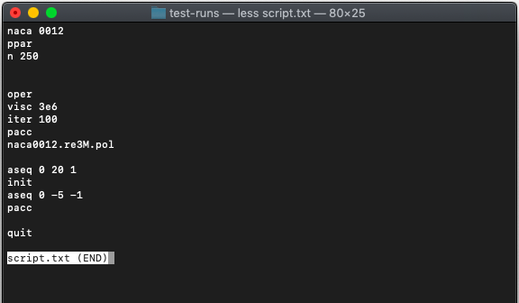
Automating Xfoil
xfoil < script.txt
What’s in script.txt?

Slide 15
NACA 2412 run
Let’s try again with a cambered airfoil
Create a file called script_2412.txt
Copy each xfoil command to script_2412.txt
Including <enter>

Slide 16
NACA 2412 run
Alpha range: -5 to 24 deg
Re = 1M
Useful commands:
NACA, PPAR
OPER, VISC, ITER, INIT, PACC, ASEQ
Check results in pplot

Slide 17
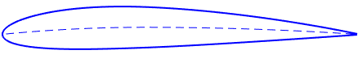
Loading custom airfoils
Input format:
x-coordinate | y-coordinate
TE to LE US, LE to TE LS.
http://m-selig.ae.illinois.edu/ads/coord_database.html
LOAD sd7003.dat

Slide 18
Load airfoil run
Instead of using the NACA 2412 airfoil, let’s use the sd7003 airfoil from Prof. Selig’s website.
Change the script we created for NACA 2412, create script_sd7003.dat
xfoil < script_sd7003.dat
Check results

Slide 19
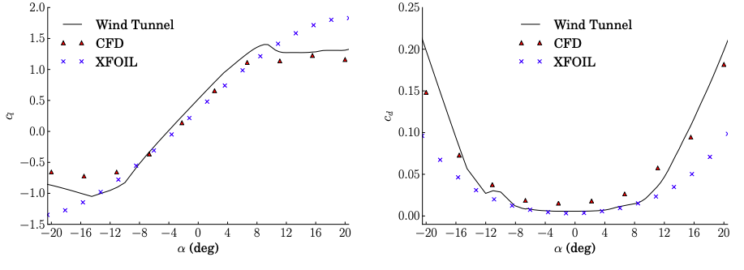

Comparing to experiment
Overpredicts $C_{l,max}, α_{stall}$
Underpredicts $C_{d}$
Comparison of airfoil analysis techniques (XFOIL vs. RANS CFD vs. Wind Tunnel) for the DU21 A17 airfoil with a Reynolds number of 1x10⁶
Source: Barrett, Ryan and Ning, Andrew, “Comparison of Airfoil Precomputational Analysis Methods for Optimization of Wind Turbine Blades” (2016). All Faculty Publications. 1671. https://scholarsarchive.byu.edu/facpub/1671

Slide 20
Questions?

