Slide 1
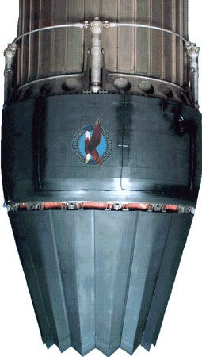
MAE 352 – Experimental Aerodynamics II Lab 4 – Converging Nozzle Analysis
Shreyas Narsipur
NCSU
March 5th, 2019

Slide 2
Outline
Lab 4 - Objective
Lab 4 – Theory
Lab 4 - Expectations

Slide 3
Lab 4 - Objective
Understand the nozzle test rig in NCSU’s supersonic wind tunnel facility.
Observe the different regimes of flow in a converging nozzle.
Plot and study the pressure variations across the converging nozzle from no-flow to chocked flow condition.

Slide 4
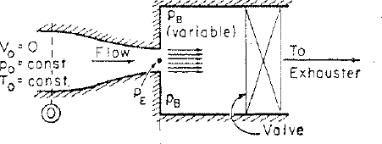
Lab 4 - Theory
Converging nozzles are used to accelerate the fluid in subsonic gas.
The back pressure (p_{B})/ temperature (T_{B}) is the driving factor that determines the flow condition in the nozzle.
When p_{O} = p_{B}, there is no flow through the nozzle.
As p_{B} is reduced, the Mach number at the exit (p_{E}) keeps rising until the flow is chocked (M_{E} = 1).
The condition at which chocked flow occurs can be calculated using the isentropic relations, and for a γ = 1.4 when,
$\frac{p_{B}}{p_{O}}=0.5283$
$\frac{T_{B}}{T_{O}}=0.8333$
M_{E} = 1

Slide 5
Lab 4 - Theory
The following are the flow conditions that can be observed in a converging nozzle,
No flow condition, where the back pressure is equal to the total pressure.
Subsonic flow, where the flow accelerates as area decreases and the pressure drops.
Subsonic flow, significantly higher acceleration and pressure drops.
Choked flow, where any pressure drop does not accelerate the flow.
Choked flow, where the flow expands after the nozzle exit (considered non-isentropic).
The Mach number cannot exceed 1 in a converging nozzle due to chocking of flow.

Slide 6
Lab 4 – Expectations
Using the nozzle test rig in NCSU’s supersonic wind tunnel facility, characterize the converging nozzle.
Data acquired:
Plot the following data (calculated at the tap locations) with respect to the normalized nozzle distance for all runs:
p/p_{O}
Mach Number
Identify the flow regimes and flow conditions in the above.
Plot the mass flow parameter (MFP) with respect to the back pressure ratio (p_{B}/p_{O}).
Tap Number | Tap Axial Positon (inches) | Nozzle Area Ratio (A/Ai) | P_{static} (psi) | P_{O} (psi) | Mass Flow Rate (slugs/second) | P_{atm} (psi)

Slide 7
Lab 4 – Expectations
Pressure readings from tap 10 can be considered as the back pressure (p_{B}) conditions.
Pressure readings from tap 9 can be assumed to be the exit pressure (p_{E}) conditions.
EXTRA CREDIT: We know that, in a converging nozzle, at p_{B}/p_{O} = 0.5283 and T_{B}/T_{O} = 0.8333, Mach number at the nozzle exit should be 1 (M_{E} = 1). Based on the above plots, find out if the above condition holds true for the current experiment. If the above condition does not agree with theory, explain why?

