Slide 1
MAE 352 – Experimental Aerodynamics II Lab 3 – Supersonic Flow Visualization
Shreyas Narsipur
NCSU
February 18th, 2019

Slide 2
Outline
Lab 3 - Objective
Lab 3 – Theory
Lab 3 - Expectations

Slide 3
Lab 3 - Objective
Understand and implement streakline flow visualization technique.
Conduct various parametric studies to analyze flow patterns in supersonic flow.

Slide 4
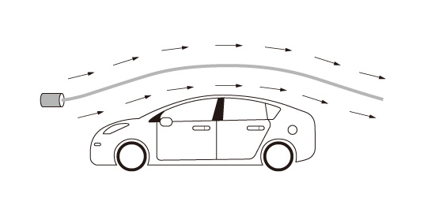
Lab 3 - Theory
Streakline is the locus of the positions of the fluid particles, at a particular instant, which have passed through a same fixed point.
To obtain a streakline for any given point all the fluid particles passing through that point are marked with a dye or smoke.
At any particular instant, after we have started marking fluid particles, these fluid particles can be identified in the flow and the line joining them will be the streakline passing through the given point.

Slide 5
Lab 3 – Expectations
Using streakline flow visualization, conduct the following parametric studies:
2-D and 3-D wedge at 3 different angles of attack (Mach 3).
Axisymmetric cone at 3 different angles of attack (Mach 3).
Missile with fins at 3 different angles of attack (Mach 3).
3 blunt-edge tubes with varying leading-edge thickness (Mach 3).
Sphere at 3 different Mach numbers (Mach 2, 2.5, and 3).
Analyze the streakline flow images and discuss the observations made.

