Slide 1
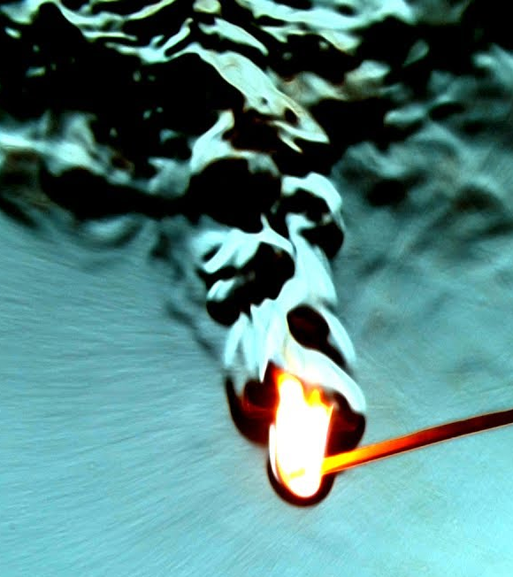
MAE 352 – Experimental Aerodynamics II
Lab 2 – Shock Wave Analysis
Shreyas Narsipur
NCSU
February 5th, 2019

Slide 2
Outline
Lab 1 - Solutions
Lab 2 - Objective
Lab 2 – Theory
Lab 2 - Expectations

Slide 3

Lab 1 - Solutions
$${M_{isentropic}:M}_{∞}=1.82×{10}^{−7}{BN}^{2}−1.3×{10}^{−3}BN +3.90$$
$${M_{rayleigh}:M}_{∞}=2.15×{10}^{−8}{BN}^{2}−1.4×{10}^{−4}BN +3.923$$
$$Manufacturers Data$$
$$M_{∞}=1.17×{10}^{−13}{BN}^{4} −7.37×{10}^{−10}{BN}^{3}+1.83×{10}^{−6}{BN}^{2}−2.80×{10}^{−3}BN +4.14$$

Slide 4
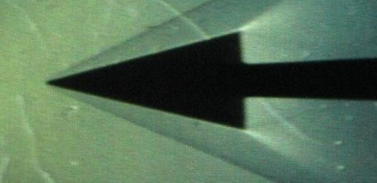
Lab 2 - Objective
Understand and implement Schlieren imaging technique for flow visualization
Determine the shock characteristics of a 2-D wedge in supersonic flow.
Plot the Ɵ-β-M curves for the wedge at different Mach numbers.

Slide 5
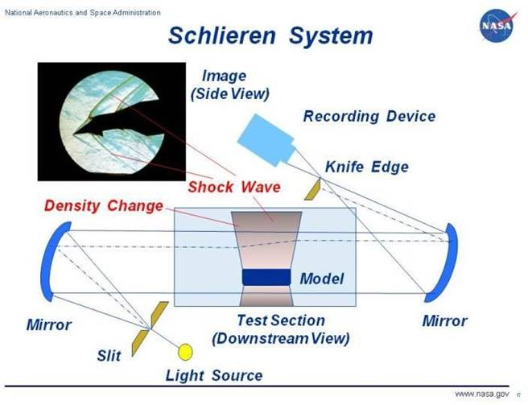
Lab 2 - Theory
Due to the large fluctuations in properties, specifically density, across a shock wave, it is possible to observe a shock wave using Schlieren photography.
A Schlieren system consists of a strong, coherent light source, a slit, a set of mirrors, and a recording device.

Slide 6
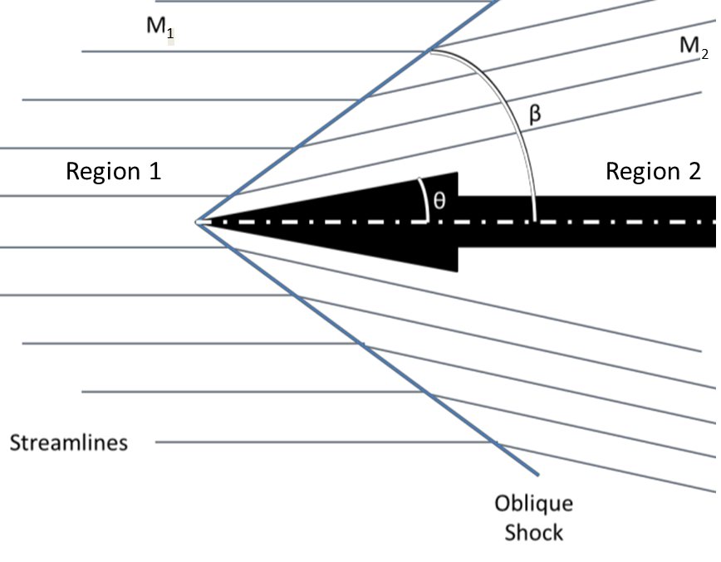
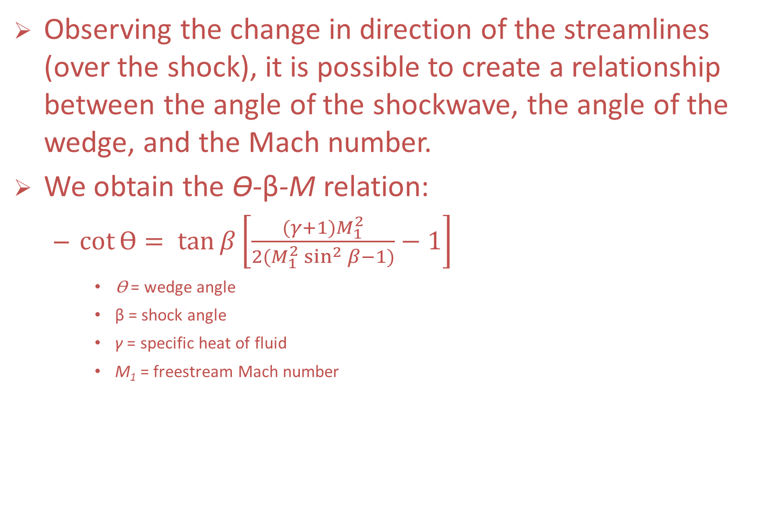
Lab 2 - Theory
Observing the change in direction of the streamlines (over the shock), it is possible to create a relationship between the angle of the shockwave, the angle of the wedge, and the Mach number.
We obtain the Ɵ-β-M relation:
  $\cot{Ɵ}= \tan{β}\left[\frac{(γ+1)M_{1}^{2}}{2(M_{1}^{2}\sin^{2}{β}−1)}−1\right]$
    Ɵ = wedge angle
    β = shock angle
    γ = specific heat of fluid
    M₁ = freestream Mach number

Slide 7
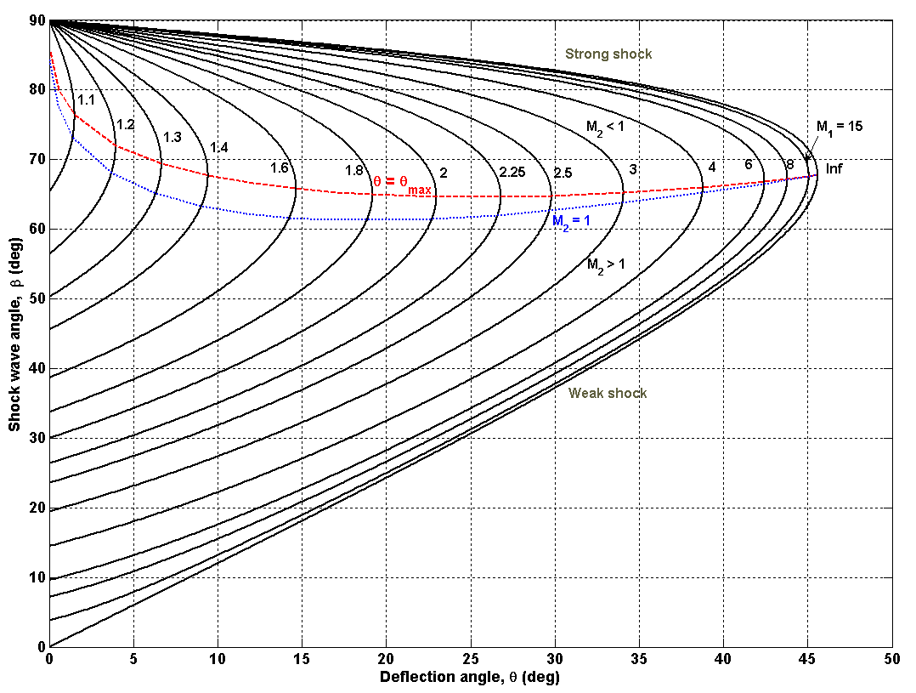
Lab 2 - Theory
The Ɵ-β-M relationship will produce two β angles for a given Ɵ and M_{1.}
M₂ is always less than M₁ and can still be supersonic (weak shock wave) or subsonic (strong shock wave).
The blue line separates the strong and weak solutions.
A maximum corner angle, Ɵ_{MAX}, exists for any upstream Mach number.
When Ɵ > Ɵ_{MAX}, the oblique shock wave is no longer attached to the corner and is replaced by a detached bow shock.

Slide 8
Lab 2 – Expectations
Using the Schlieren images and the data from the pressure transducers, calculate the freestream Mach.
Data acquired:
Plot the shock wave angle versus wedge angle for different freestream Mach number settings.
Co-plot and compare your results with theoretical analysis using the Ɵ-β-M relationship.
Calculate and plot the Mach number vs. block number from the freestream static and stagnation pressure data using the isentropic relation and compare it to the Mach number obtained from the Ɵ-β-M relation.
Additionally, compare the above data with similar results from Lab-1.
time (s) | P₀₁ (psi) | P₁ (psi) | P_{atm} (psi) | T₀₁ (ºF)

