Slide 1
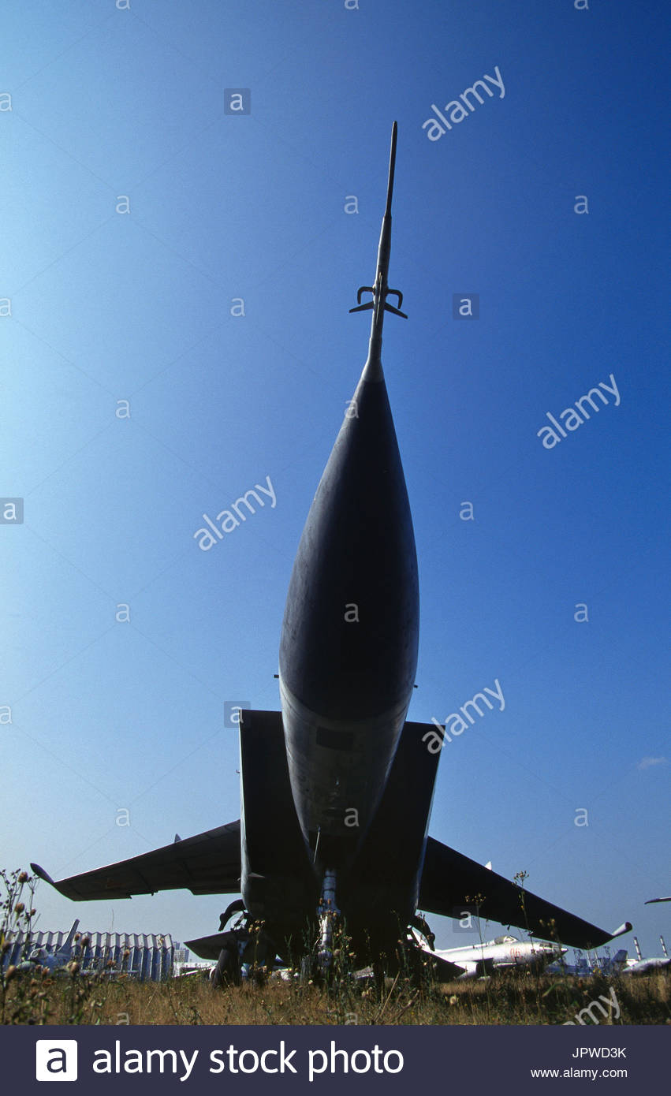
MAE 352 – Experimental Aerodynamics II General Information and Lab 1 (Supersonic Wind Tunnel Block Calibration)
Shreyas Narsipur
NCSU
January 22nd, 2019

Slide 2
Outline
General Information and Course Objectives
Lab 1 - Objective
Lab 1 – Theory
Lab 1 - Expectations

Slide 3
General Information and Course Objectives
Focus will be on optimized data acquisition and analysis techniques (LabView, Matlab, etc.).
Lab reports in AIAA technical report format:
A short introduction will be required for each experiment.
Discuss the experimental setup, equations used to correct or reduce the data, and the steps taken to obtain your results in the methodology section.
A detailed discussion of the plots should be provided in the results section.
Codes (if any) can be provided in the appendix.
75% individual assignments and 25% group project work.
Attendance is mandatory.
BE SAFE!

Slide 4
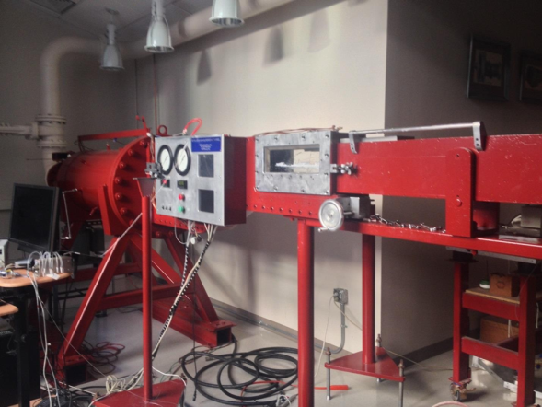
Lab 1 - Objective
A basic understanding of the supersonic wind tunnel instrumentation.
Create a calibration curve for the block setting of the supersonic wind tunnel with the Mach number.

Slide 5
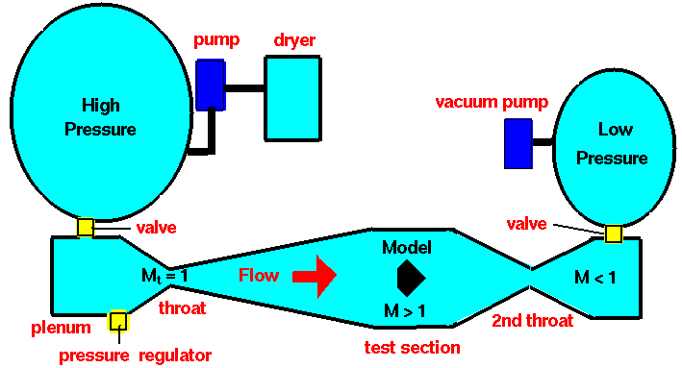
Lab 1 - Theory
The block in a supersonic wind tunnel is the piece that determines the shape of the nozzle throat.
In the case of our tunnel, the block is continuously adjustable and can generate flow from M = 1.5 – 3.5.
It is desirous to know the Mach number to within about 0.1 percent.

Slide 6
Lab 1 - Theory
There are a number of ways to obtain information about the Mach number in a supersonic flow.
Method 1 – Isentropic relation
Given the stagnation and static pressure before the shock
$\frac{P_{01}}{P_{1}}= {\left(1+\frac{γ−1}{2}M^{2}\right)}^{\frac{γ}{\left(γ−1\right)}}$
P₀₁ = stagnation pressure before shock
P₁ = static pressure before shock
γ = specific heat of fluid
M = Mach number

Slide 7
Lab 1 - Theory
Method 2 – Pitot probe
The introduction of a Pitot probe into the flow stream, leads to a detached bow shock.
The Rayleigh Pitot tube formula can be used to determine the Mach number.
${\frac{P_{02}}{P_{1}}= \left[\frac{{\left(γ+1\right)}^{2}M^{2}}{{4γM}^{2}−2\left(γ−1\right)}\right]}^{\frac{γ}{\left(γ−1\right)}} \left[\frac{{1−γ+2γM}^{2}}{γ+1}\right]$
P₀₂ = stagnation pressure after shock
P₁ = static pressure before shock
γ = specific heat of fluid
M = Mach number

Slide 8
Lab 1 – Expectations
Create a plot between the block number setting and the Mach number obtained using the isentropic and Rayleigh Pitot tube relations.
Data acquired:
Create two best fit polynomials through the data.
Provide the equations of the polynomial fits.
Compare the calibration data with manufacture data sheet.
Extra credit for those who get the correct degree polynomial fits.
time (s) | P₀₁ (psi) | P₁ (psi) | P₀₂ (psi) | P_{atm} (psi) | T₀₁ (ºF)

