Slide 1
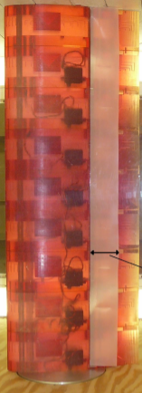
MAE 253 – Experimental Aerodynamics I Lab 5 – Airfoil Aerodynamics (Drag)
Shreyas Narsipur
NCSU
March 18th, 2019

Slide 2
Outline
Lab 5 - Objective
Lab 5 – Theory
Lab 5 - Expectations

Slide 3
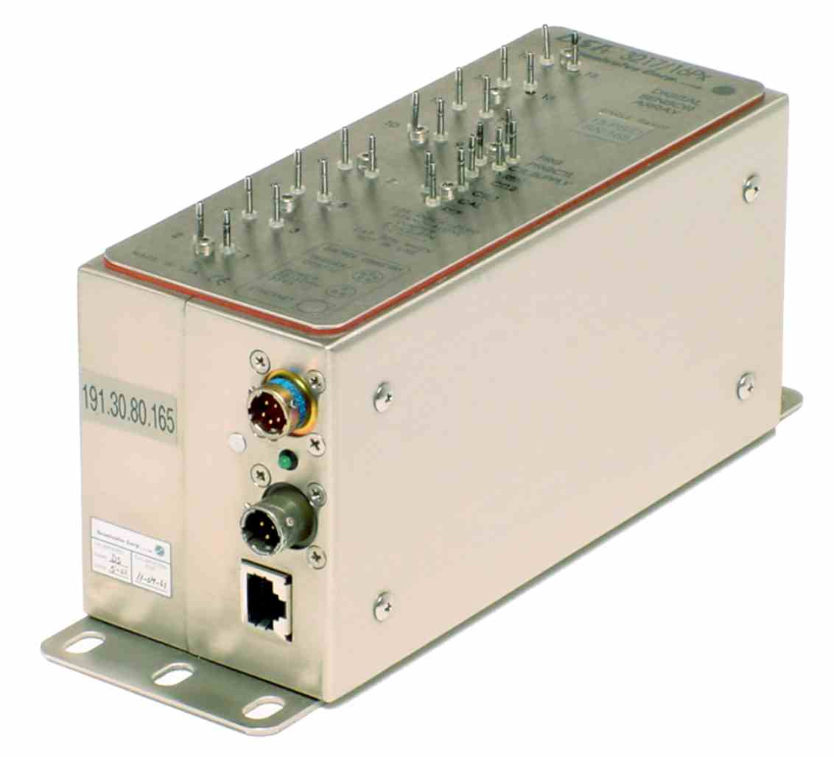
Lab 5 - Objective
Breakdown of automation techniques in LabView.
Study the drag characteristics of the airfoil.

Slide 4
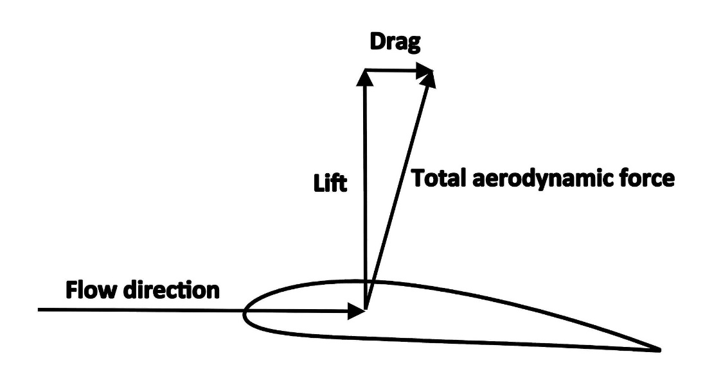

Lab 5 - Theory
Drag is the parallel (to oncoming flow direction) component of the force exerted on a body due to the fluid flow.
$C_{d}= \frac{D}{\frac{1}{2}ρ_{∞}V_{∞}^{2} c}$
C_{d} – coefficient of lift
D – lift force
ρ – density of fluid
V∞ - freestream velocity
c – airfoil chord

Slide 5
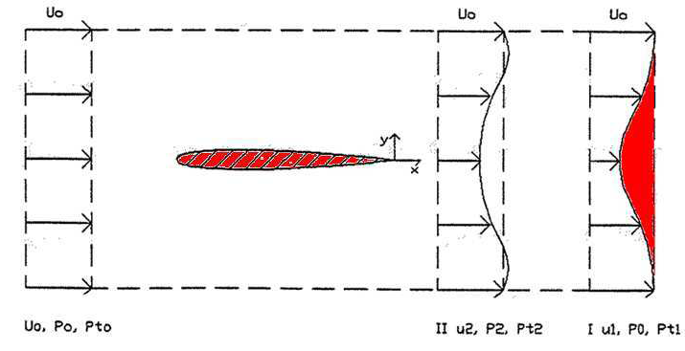

Lab 5 - Theory
The profile drag of the airfoil can be calculated by measuring the pressure/momentum deficit in the wake of the airfoil.
Done using the wake-rake system.
Area under the pressure deficit curve gives us the drag coefficient.
$C_{d}= \frac{1}{cq_{∞}}\int_{wake}{\left(p_{∞, total} − p_{wake, total}\right)dy}$
In MATLAB, the trapz() function gives you the area under a curve.

Slide 6
Lab 5 – Expectations
Data acquired:
Total pressure data at different angles of attack and Reynolds numbers.
10 readings per angle of attack.
Co-plot the pressure-deficit distributions at all angles of attack for a given Reynolds number.
Plot the C_{d} vs. α curve for the airfoil and compare the data to XFOIL predictions.
Constants:
airfoil chord, c = 0.3048m
dynamic viscosity, μ_{air} = 1.825x10⁻⁵ Pa s

Slide 7
Lab 5 – Interim Correction to C_{d} Data
Due to wind tunnel restrictions, static pressure at the point of measurement was unable to recover to freestream conditions.
As an interim correction, while calculating C_{d} for the given angle-of-attack, only consider the positive pressure deficit area curve (as shown in red) instead of the complete area under the curve (outlined in black).
Note that this is just a fix. To get accurate C_{d} values, you will have to apply the pressure correction equations given in Schlichting’s ‘Boundary-Layer Theory’.

