Slide 1
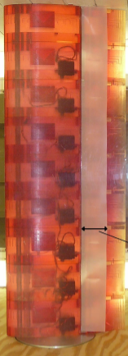
MAE 253 – Experimental Aerodynamics I
Lab 3 – Airfoil Aerodynamics (Lift)
Shreyas Narsipur
NCSU
February 12th, 2019

Slide 2
Outline
Lab 2 - Solutions
Lab 3 - Objective
Lab 3 – Theory
Lab 3 - Expectations

Slide 3
Lab 2 - Solutions
TF (average) = 1.2515
% turbulence (average) = 0.3002

Slide 4
Lab 2 - Experimental Flow Diagram

Slide 5
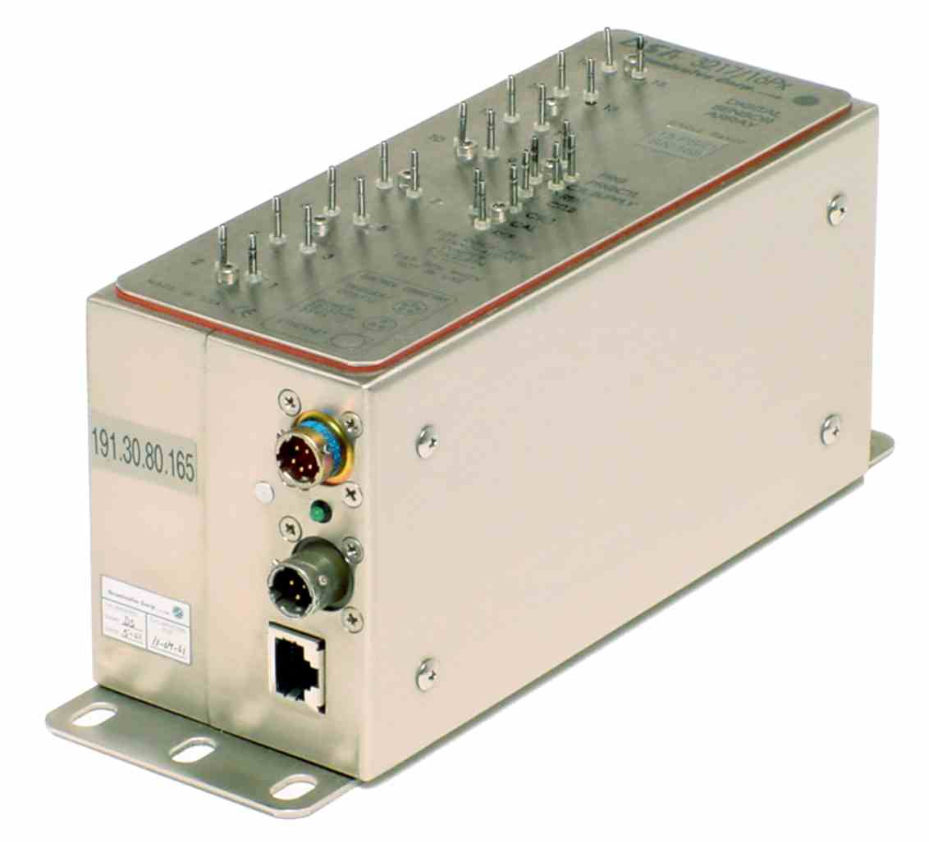
Lab 3 - Objective
Basic understanding of the multi-port pressure measurement system.
Insight into basic automation techniques in experimental aerodynamics research.
Study the lift characteristics of the airfoil.

Slide 6
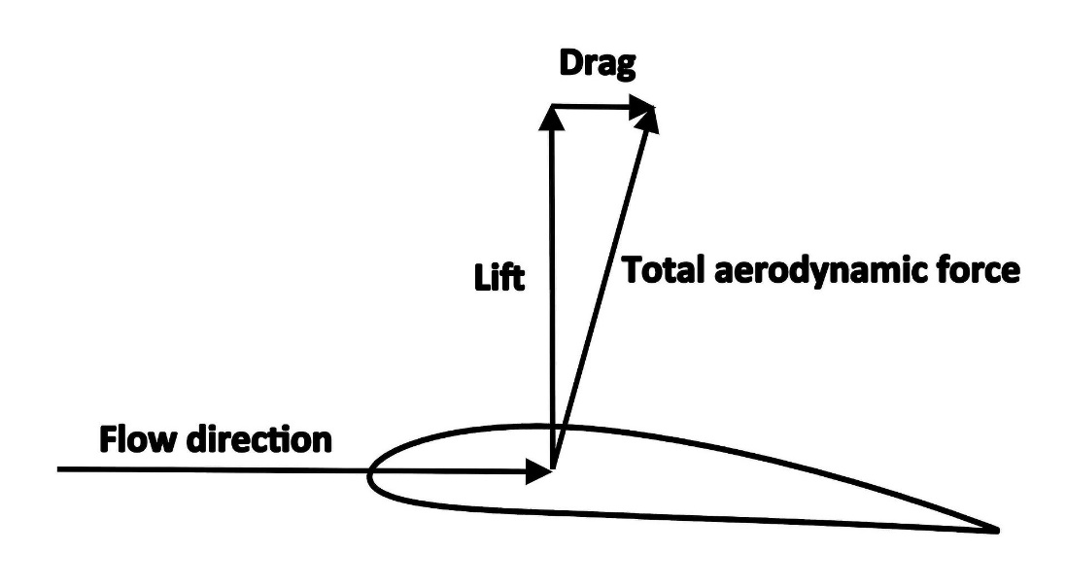
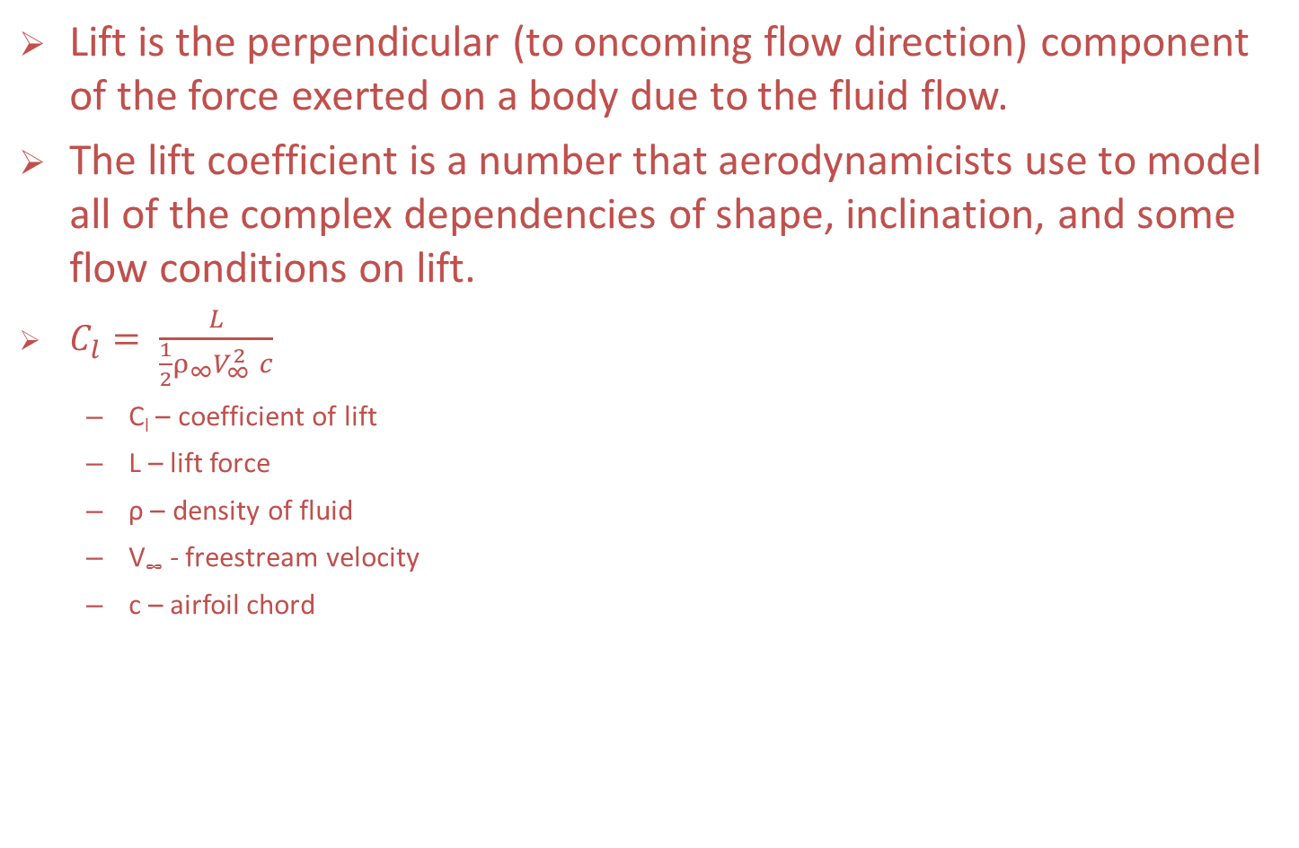
Lab 3 - Theory
Lift is the perpendicular (to oncoming flow direction) component of the force exerted on a body due to the fluid flow.
The lift coefficient is a number that aerodynamicists use to model all of the complex dependencies of shape, inclination, and some flow conditions on lift.
$C_{l}= \frac{L}{\frac{1}{2}ρ_{∞}V_{∞}^{2} c}$
  C_{l} – coefficient of lift
  L – lift force
  ρ – density of fluid
  V∞ - freestream velocity
  c – airfoil chord

Slide 7
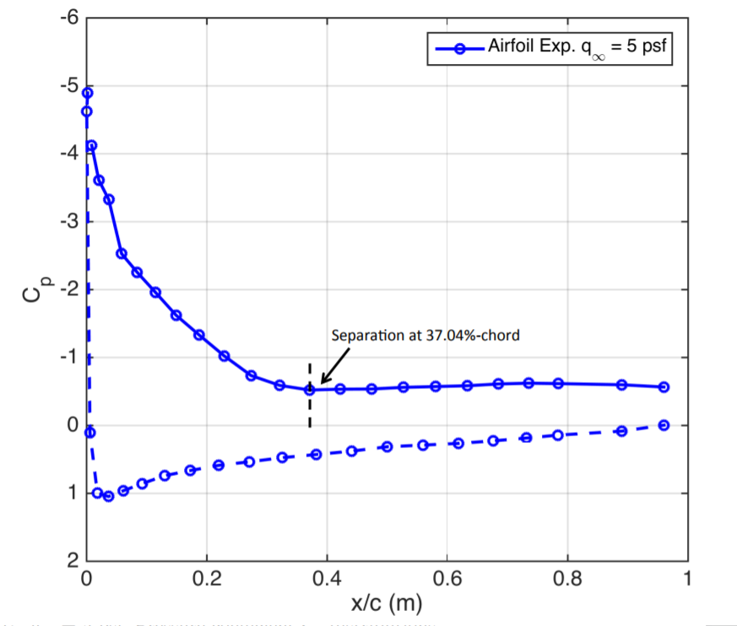
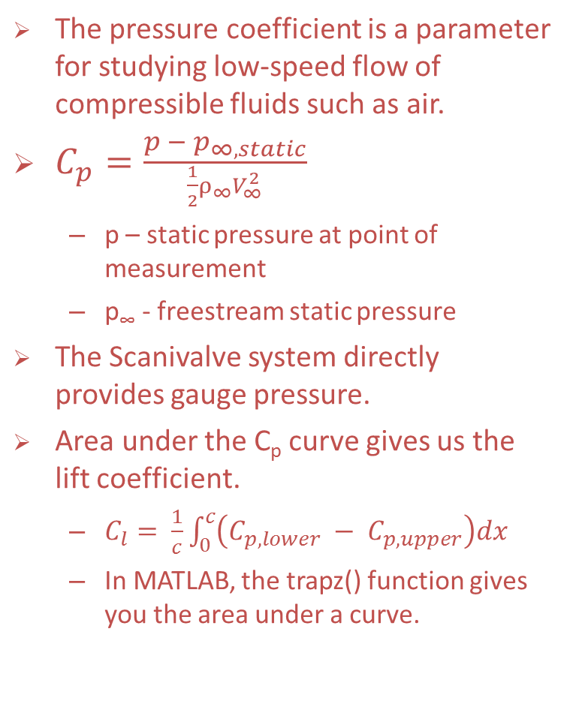
Lab 3 - Theory
The pressure coefficient is a parameter for studying low-speed flow of compressible fluids such as air.
$C_{p}=\frac{p − p_{∞, static}}{\frac{1}{2}ρ_{∞}V_{∞}^{2}}$
  p – static pressure at point of measurement
  p∞ - freestream static pressure
The Scanivalve system directly provides gauge pressure.
Area under the C_{p} curve gives us the lift coefficient.
  $C_{l}= \frac{1}{c}\int_{0}^{c}{\left(C_{p, lower} − C_{p, upper}\right)dx}$
  In MATLAB, the trapz() function gives you the area under a curve.

Slide 8
Lab 3 - Experimental Flow Diagram

Slide 9
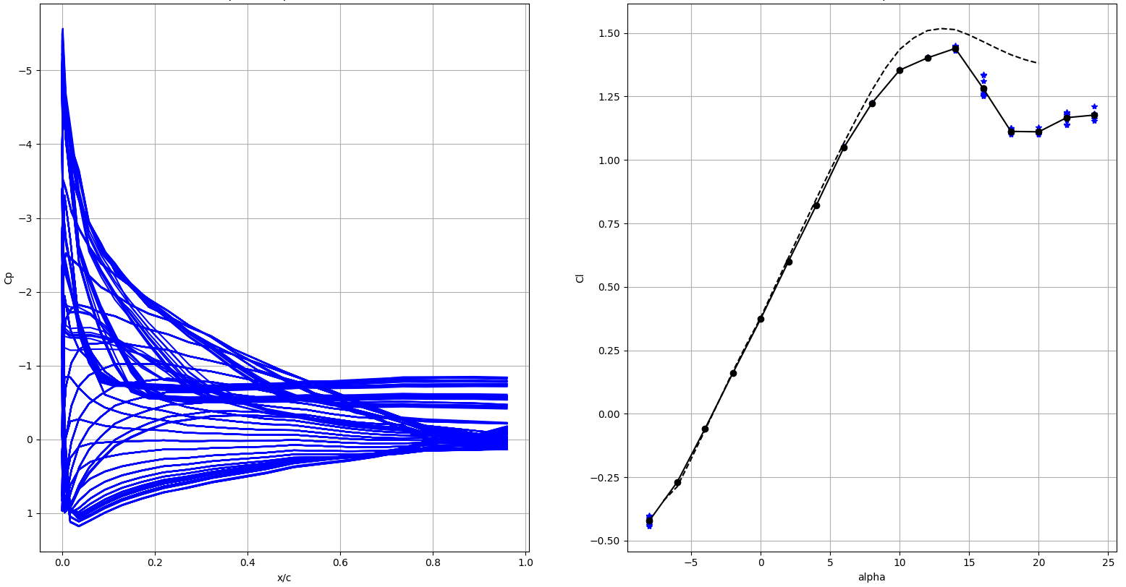
Lab 3 – Expectations
Data acquired:
  Static pressure data at different angles of attack and Reynolds numbers.
  10 readings per angle of attack.
Co-plot the C_{p} distributions at all angles of attack for a given Reynolds number.
Plot the C_{l} vs. α curve for the airfoil with error bars and compare the data to XFOIL predictions.
Constants:
  airfoil chord, c = 0.3048m
  dynamic viscosity, μ_{air} = 1.825x10⁻⁵ Pa s
  TF = 1.2512

