Slide 1
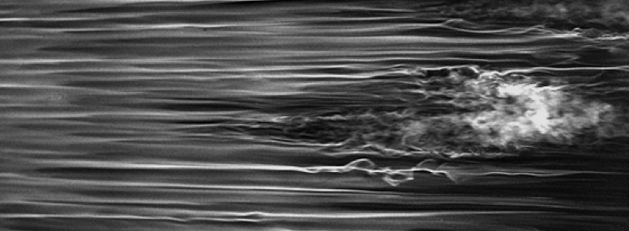
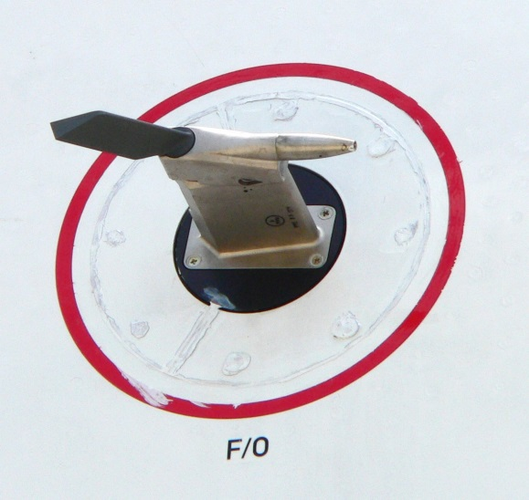
MAE 253 – Experimental Aerodynamics I Lab 2 – Wind Tunnel Turbulence Study
Shreyas Narsipur
NCSU
February 6th, 2018

Slide 2
Outline
Lab 1 - Solutions
Lab 2 - Objective
Lab 2 – Theory
Lab 2 - Expectations

Slide 3
Lab 1 - Solutions
$${Increasing Velocity: I}_{sensor}=0.0121{ P}_{manometer}+4.1194$$
$${Decreasing Velocity:I}_{sensor}=0.0121{ P}_{manometer}+4.1501$$

Slide 4
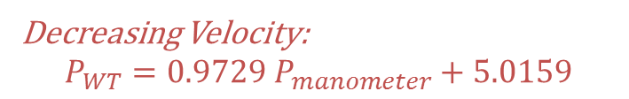
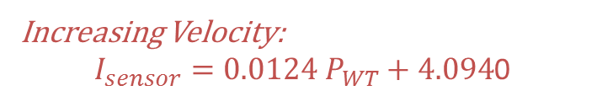
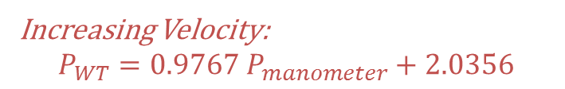
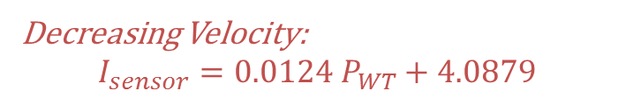
Lab 1 - Solutions
Increasing Velocity:
$I_{sensor}=0.0124{ P}_{WT}+4.094$0
Increasing Velocity:
$$P_{WT}=0.9767{ P}_{manometer}+2.0356$$
Decreasing Velocity:
$$I_{sensor}=0.0124{ P}_{WT}+4.0879$$
Decreasing Velocity:
$$P_{WT}=0.9729{ P}_{manometer}+5.0159$$

Slide 5
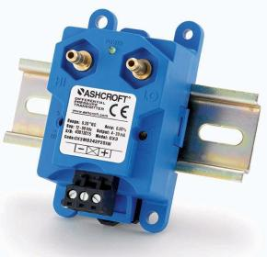
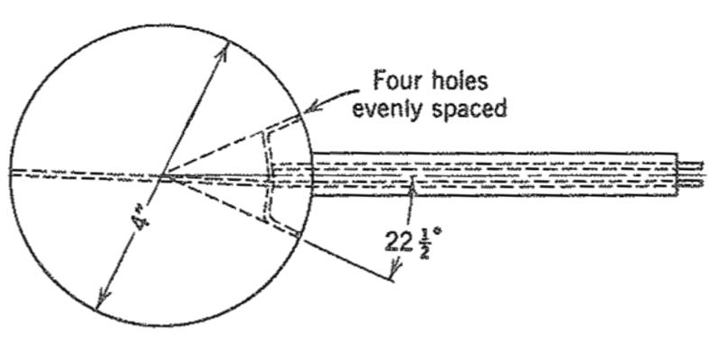
Lab 2 - Objective
Understand the turbulence sphere set-up for measuring wind tunnel turbulence..
Determine the turbulence factor and per cent turbulence of NCSU’s subsonic wind tunnel.

Slide 6
Lab 2 - Theory
What is turbulence?
The level of unsteady velocity fluctuations about the flow’s average velocity.
The turbulence in a wind tunnel is mainly produced by the propeller, the guide vanes, and the vibration of the wind tunnel walls.
The effective Reynolds number in the test section is generally higher than the freestream Reynolds number.

Slide 7
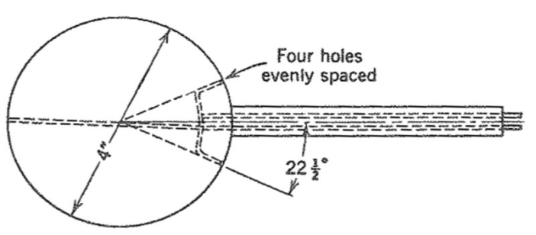
Lab 2 - Theory
Critical Reynolds number is the point at which flow over a bluff body transitions from laminar to turbulent.
higher degree of flow attachment.
reduction in drag.
Flight measurements have shown that the critical Reynolds number of a sphere in free atmosphere is 385,000 and is independent of the turbulence structure in free air.
For a sphere, the critical Reynolds number depends on the degree of turbulence in the wind tunnel.
a higher turbulence leads to faster transition.
Before the use of hot-wire anemometry, a turbulence sphere was used to measure relative turbulence of a wind tunnel.

Slide 8
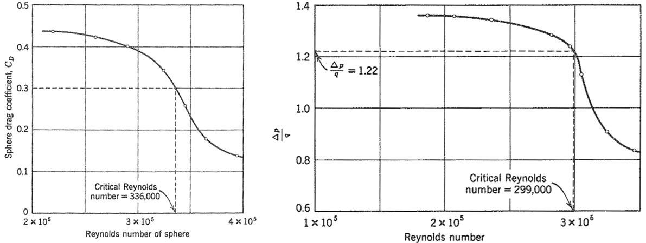
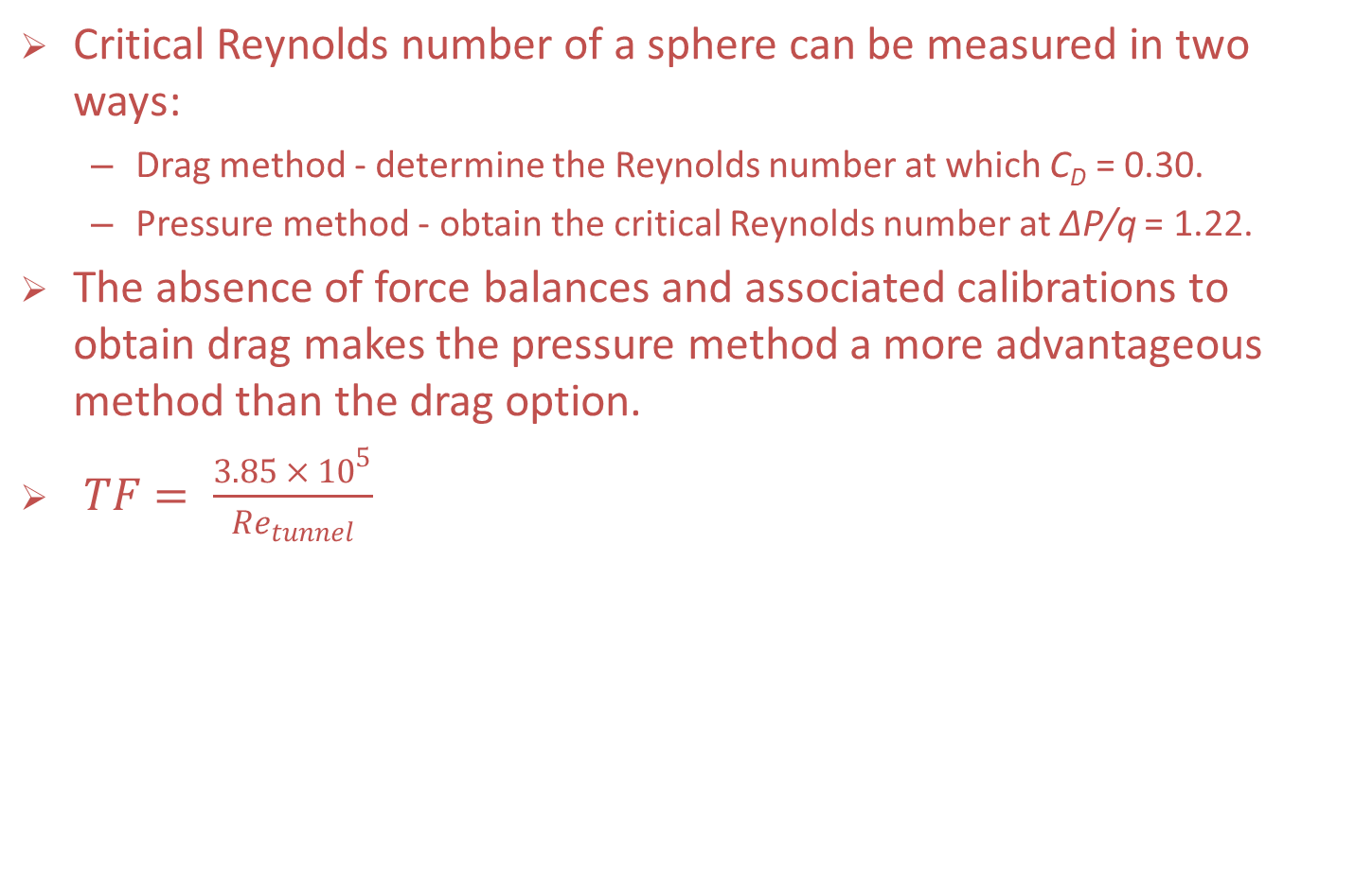
Lab 2 - Theory
Critical Reynolds number of a sphere can be measured in two ways:
Drag method - determine the Reynolds number at which C_{D} = 0.30.
Pressure method - obtain the critical Reynolds number at ΔP/q = 1.22.
The absence of force balances and associated calibrations to obtain drag makes the pressure method a more advantageous method than the drag option.
$TF= \frac{3.85 × {10}^{5}}{{Re}_{tunnel}}$

Slide 9
Lab 2 – Expectations
Data acquired:
Plot the variation of the pressure coefficient with Reynolds number for the turbulence sphere.
Determine the turbulence factor of the wind tunnel.
Determine the per cent turbulence of NCSU’s subsonic wind tunnel.
P_{transducer} (psf) | I_{sensor} (mA)

