Slide 1
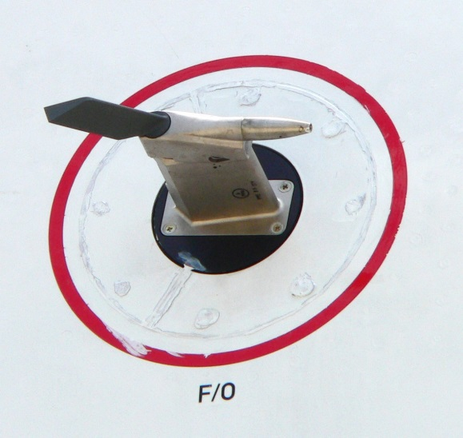
MAE 253 – Experimental Aerodynamics I
General Information and Lab 1 (Pressure Transducer Calibration)
Shreyas Narsipur
NCSU
January 15th, 2019

Slide 2
Outline
General Information and Course Objectives
Lab 1 - Objective
Lab 1 – Theory
Lab 1 - Expectations

Slide 3
General Information and
Course Objectives
Focus will be on optimized data acquisition and analysis techniques (LabView, Matlab, etc.).
Lab reports in AIAA technical report format:
  A short introduction will be required for each experiment.
  Discuss the experimental setup, equations used to correct or reduce the data, and the steps taken to obtain your results in the methodology section.
  A detailed discussion of the plots should be provided in the results section.
  Codes (if any) can be provided in the appendix.
75% individual assignments and 25% group project work.
Attendance is mandatory.
BE SAFE!

Slide 4
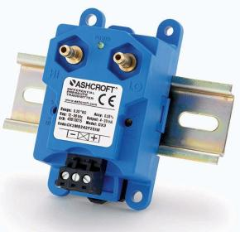
Lab 1 - Objective
A basic understanding of the subsonic wind tunnel instrumentation.
Create a calibration curve for the Ashcroft® pressure transducer using the water manometer and pitot-static probe.
Determine the pressure transducer calibration factors.

Slide 5
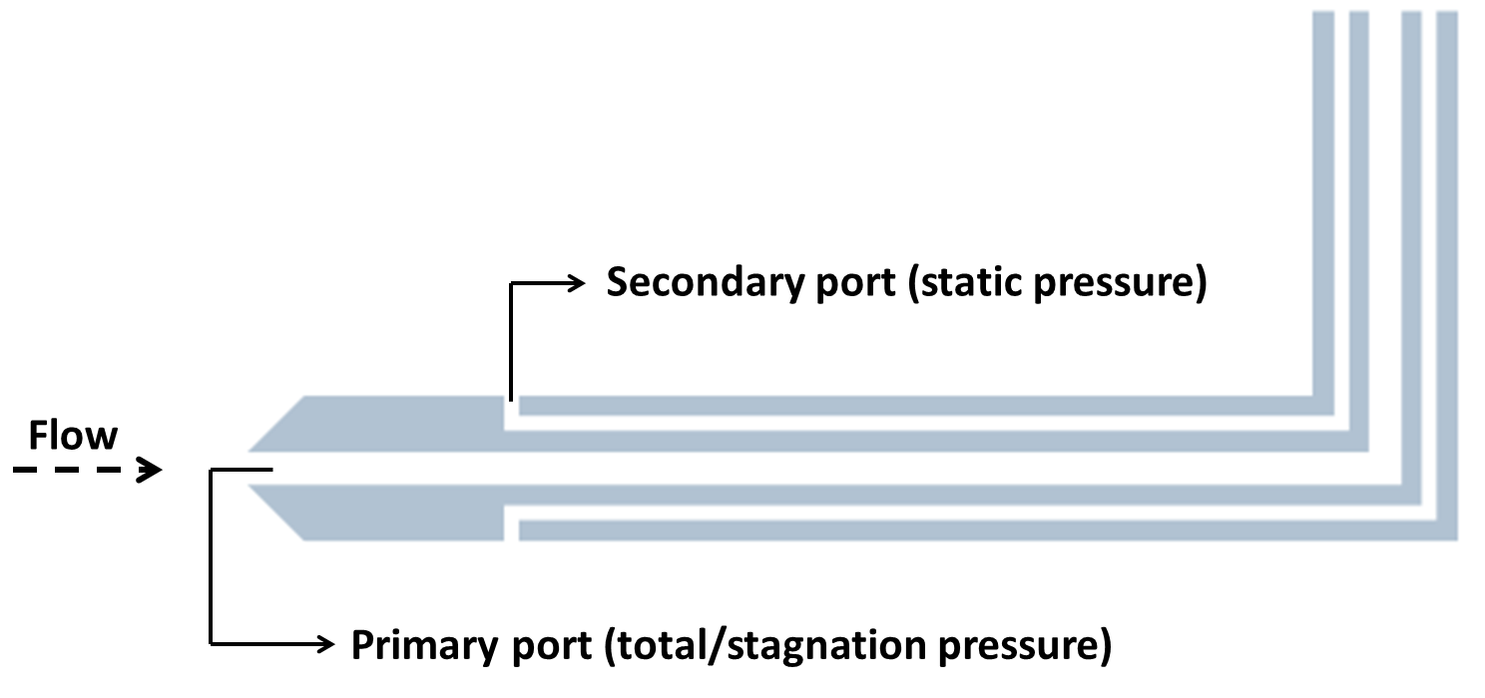
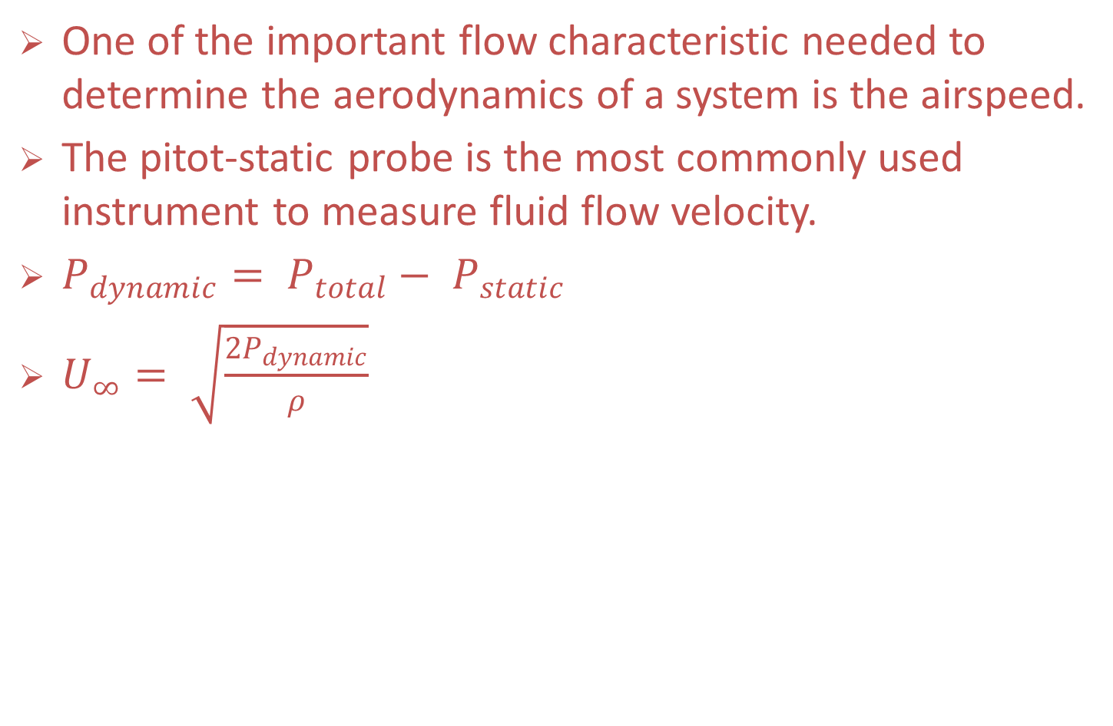
Lab 1 - Theory
One of the important flow characteristic needed to determine the aerodynamics of a system is the airspeed.
The pitot-static probe is the most commonly used instrument to measure fluid flow velocity.
$P_{dynamic}= P_{total}− P_{static}$
$U_{∞}= \sqrt{\frac{2P_{dynamic}}{ρ}}$

Slide 6
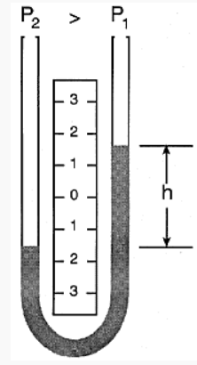
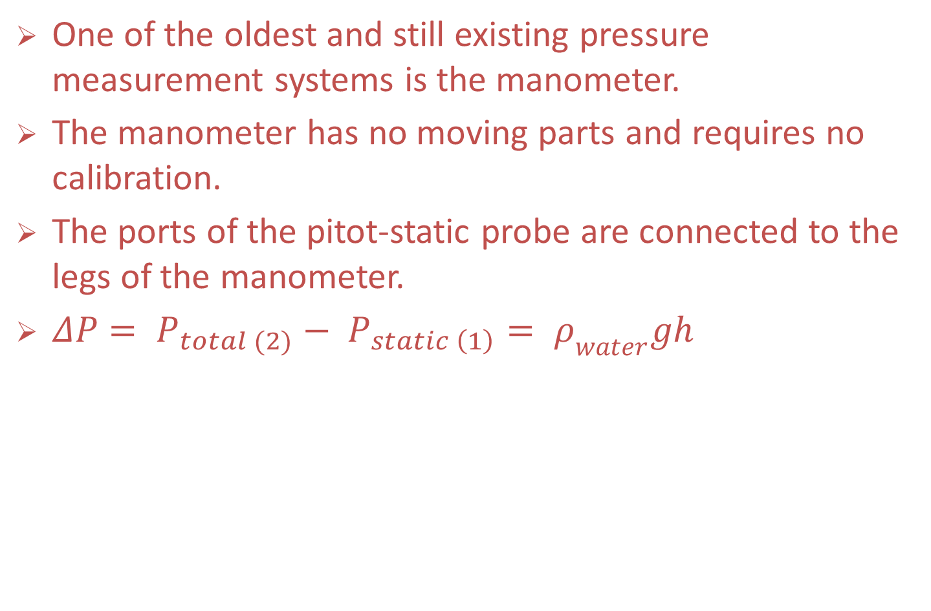
Lab 1 - Theory
One of the oldest and still existing pressure measurement systems is the manometer.
The manometer has no moving parts and requires no calibration.
The ports of the pitot-static probe are connected to the legs of the manometer.
$ΔP= P_{total (2)}− P_{static \left(1\right)}= ρ_{water}gh$

Slide 7
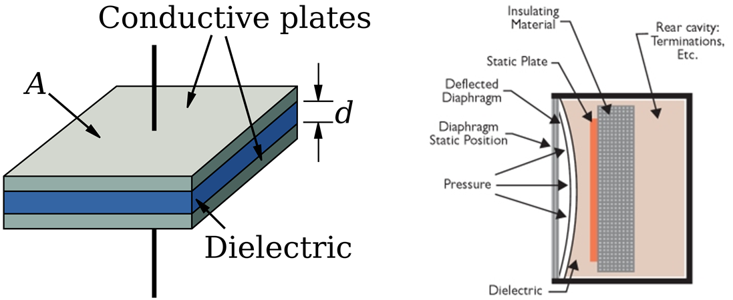

Lab 1 - Theory
Due to the bulkiness of the manometer, a more realistic solution is needed to measure pressures on moving vehicles.
One of the more common sensors are the capacitive pressure sensors.
$C= \frac{μA}{d}$

Slide 8
Lab 1 – Expectations
Create two calibration curves (increasing and decreasing velocities) for the Ashcroft® pressure sensor (P_{manometer} vs. I_{sensor}).
Data acquired:
Create a linear fit through the data points and calculate the polynomial coefficients.
Determine the hysteresis of the Ashcroft® pressure sensor.
EXTRA CREDIT - Is the wind-tunnel pressure transducer calibrated correctly?
P_{transducer} (psf) | h_{manometer} (inches) | I_{sensor} (mA) | T_{transducer} (ºF)

